Slide 1
Week 7: HTML

Slide 2
Agenda
Introductions
Questions?
Where We’re Headed
Structure of an HTML Page
Useful HTML Elements
Forms
Next Week: CSS

Slide 3
What questions do you have?

Slide 4
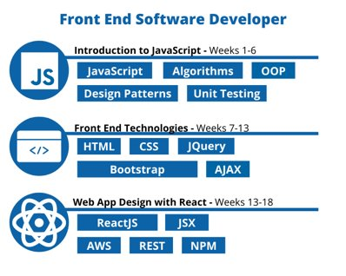
Where We’re Headed
Introduction to Javascript (weeks 1-6)
Front End Technologies (weeks 7-12)
Web App Design with React (weeks 13-18)
Career Services (every other week)

Slide 5







Where We’re Headed

Slide 6
Where We’re Headed
Week 1, 2, 3, 4, 5, 6 & 10
Week 7
Week 8
Week 9
Week 11
Week 13-18

Slide 7
Structure of an HTML Page
<!DOCTYPE html> <html> <head> <!-- Information --> </head> <body> <!-- Content --> </body> </html>
Inside the <head> we put info about the page:
<title>
Shows up in the tab in the browser
<meta>
There are lots of different ways you can use this element, like set the charset and the viewport
<link>
Usually used to pull in an external CSS file
...and more

Slide 8
Useful HTML Elements
<div>Generic Box</div> | Block | Generic block-level element (the MVP of HTML)
<a>Link</a> | Inline | How to allow navigation to different pages
<p>Paragraph</p> | Block | For significant blocks of text
<ul> <li>List Item</li> </ul> | Block | For lists of items (you can remove the bullet point) Sometimes used for links/navbars
<h1>Heading</h1> | Block | Headings - <h1> is the most important, <h6> is the least important
<img> | Inline | Images
<table></table> | Block | Should only use for tabular data
<span></span> | Inline | Generic inline-level element

Slide 9
Forms
<form>
The HTML element that holds the whole form
<label></label>
Can be connected to specific form elements by matching the for attribute of the <label> with the id attribute of the <input> or <select> or <textarea>
<input>
Many different types of inputs available: text, date, color, number, email, checkboxes, radio buttons
<select>
Creates a dropdown and holds <option> elements with each dropdown option
<textarea>
A multi-line textbox that can be resized by the user
...and more

Slide 10
Additional
Resources
5 Minute Intro to HTML Video
https://www.youtube.com/watch?v=BvJYXl2ywUE
1 Hour HTML Crash Course
https://www.youtube.com/watch?v=qz0aGYrrlhU
Form Elements
https://www.w3schools.com/html/html_forms.asp

